Slide 1

Fellowship Management 1.0
Team Members: Alfredo Morales, Winicius Siqueira Product Owner: Robert Zurita
Instructor: Masoud Sadjadi School of Computing and Information Sciences Florida International University
Final Presentation
Spring 2017
FM 1.0
Notes:
7 seconds.( I will select 2 best slides (i will give them extra points and students will present for CIS committee)
Greet your audience, thank them for attending your presentation, introduce yourself, introduce your project, introduce your team members, and quickly indicate what each of you did in a high-level manner, and put more emphasis on your part/contribution.

Slide 2
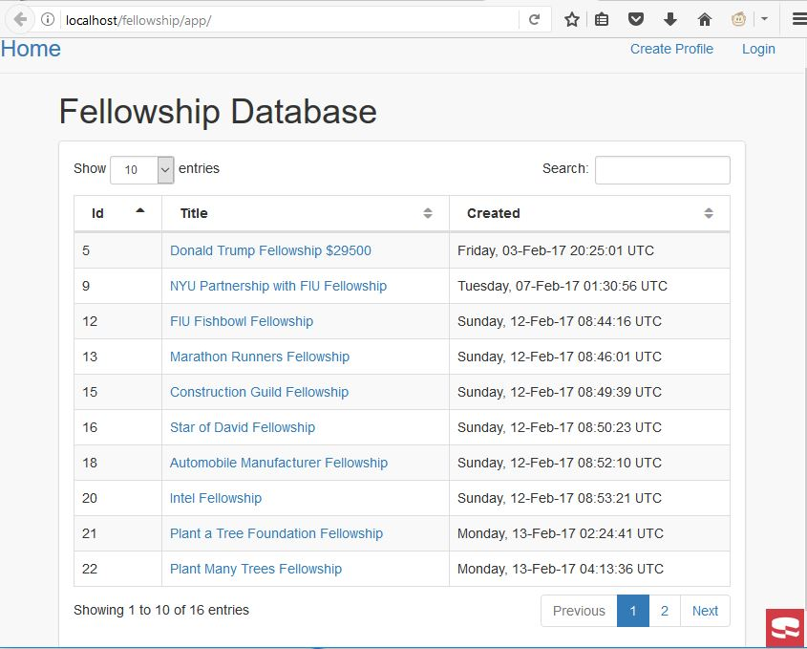
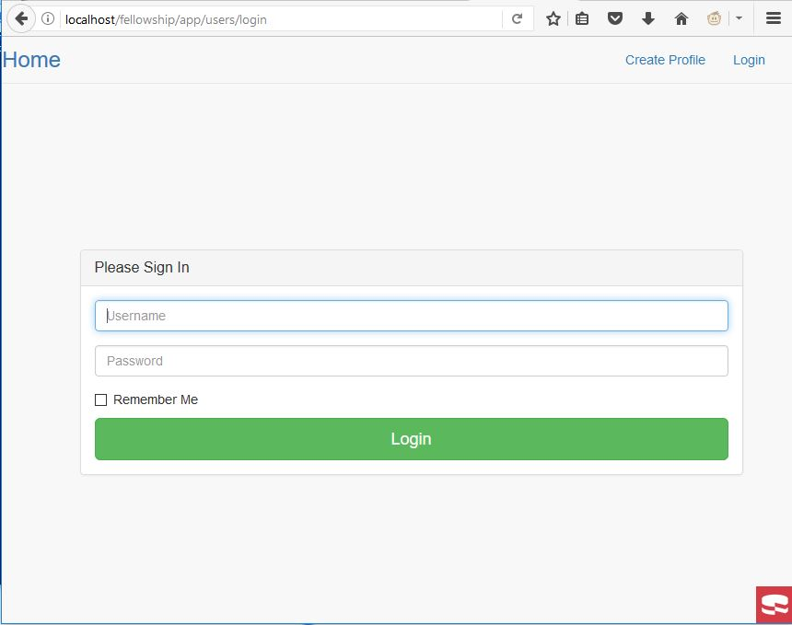
Project definition
Screenshots or GIF pictures of the new version
Notes:
20 seconds.
Introduce the problem that the your project (in new version) tackles with GIF or screenshot.

Slide 3
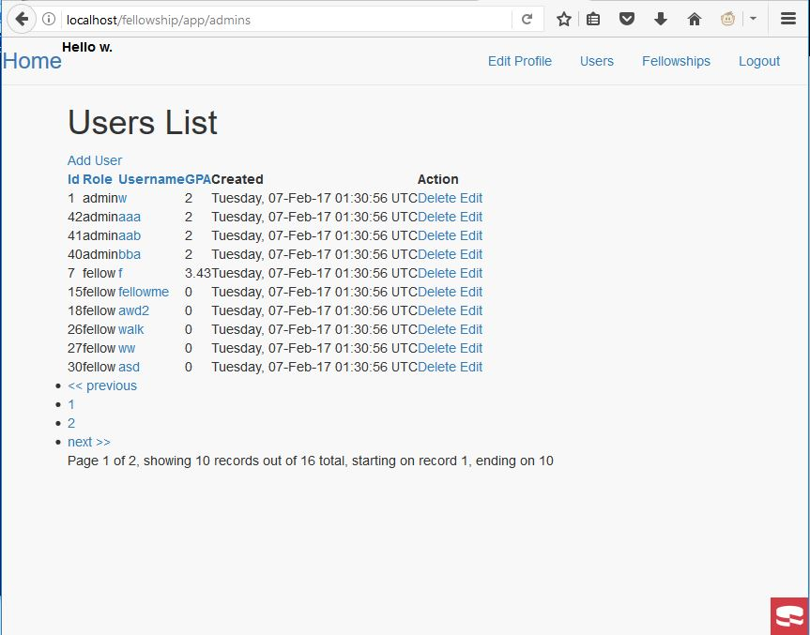
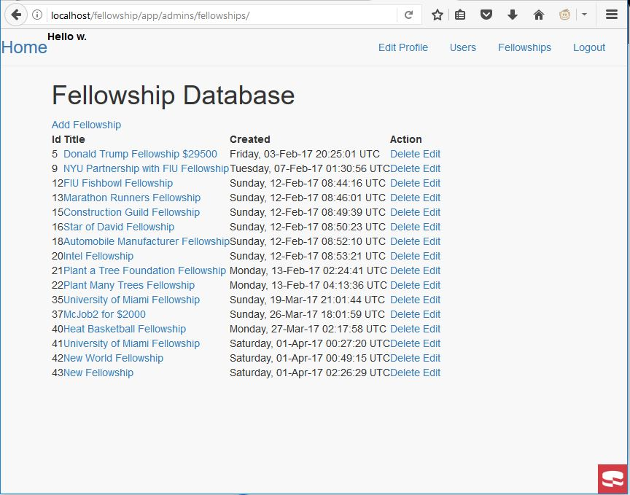
Project definition
Screenshots or GIF pictures of the new version
Notes:
20 seconds.
Introduce the problem that the your project (in new version) tackles with GIF or screenshot.

Slide 4
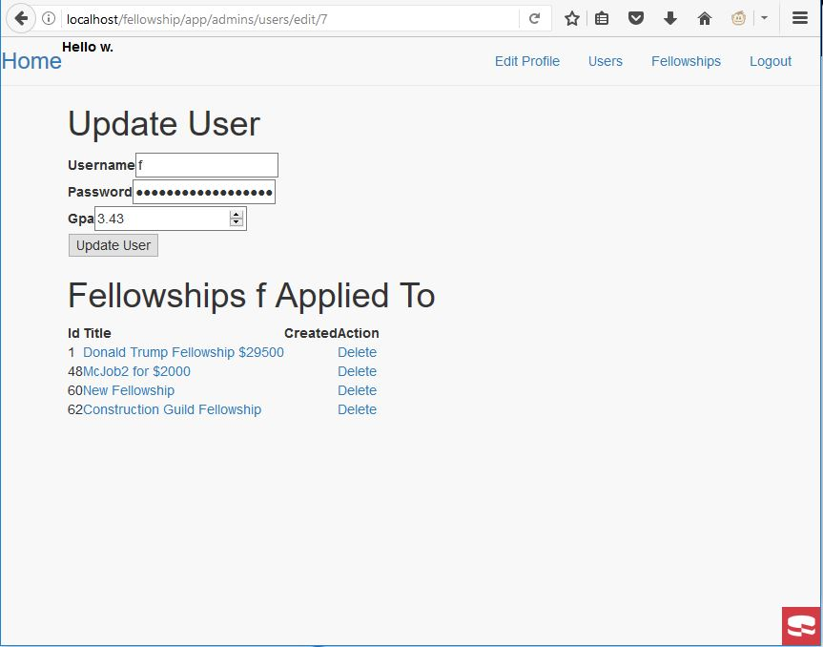
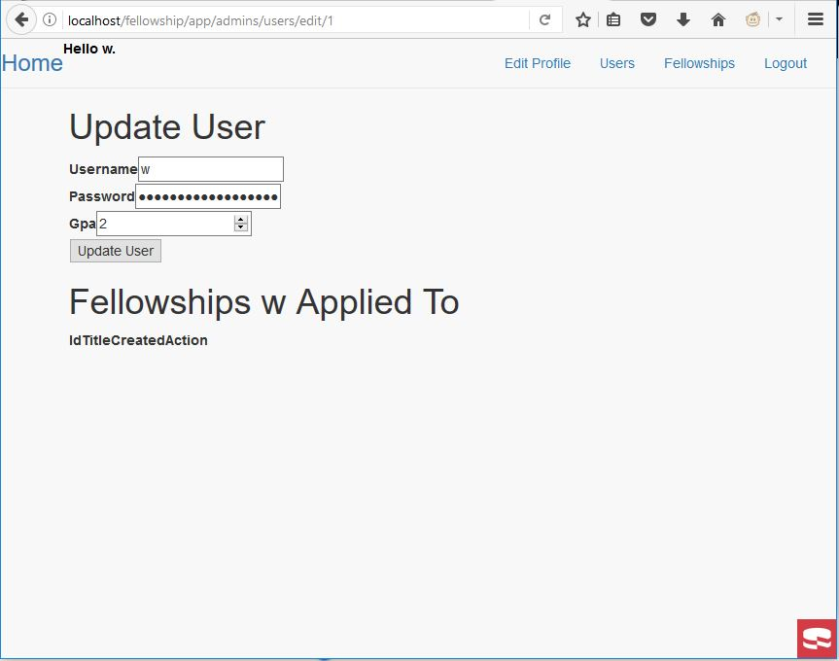
Project definition
Screenshots or GIF pictures of the new version
Notes:
20 seconds.
Introduce the problem that the your project (in new version) tackles with GIF or screenshot.

Slide 5
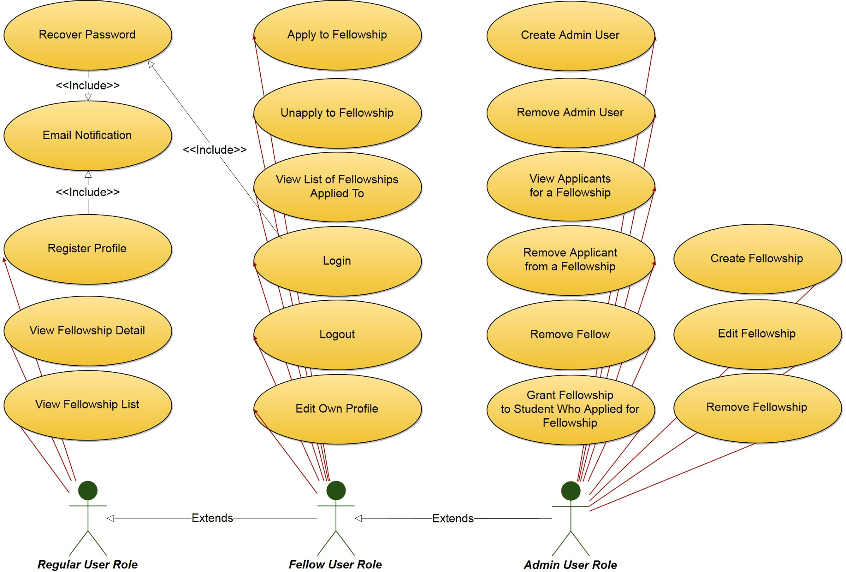
Requirements: Use Cases
Notes:
5 seconds
Show the Use Case Diagram for the whole project. Highlight your use cases.

Slide 6
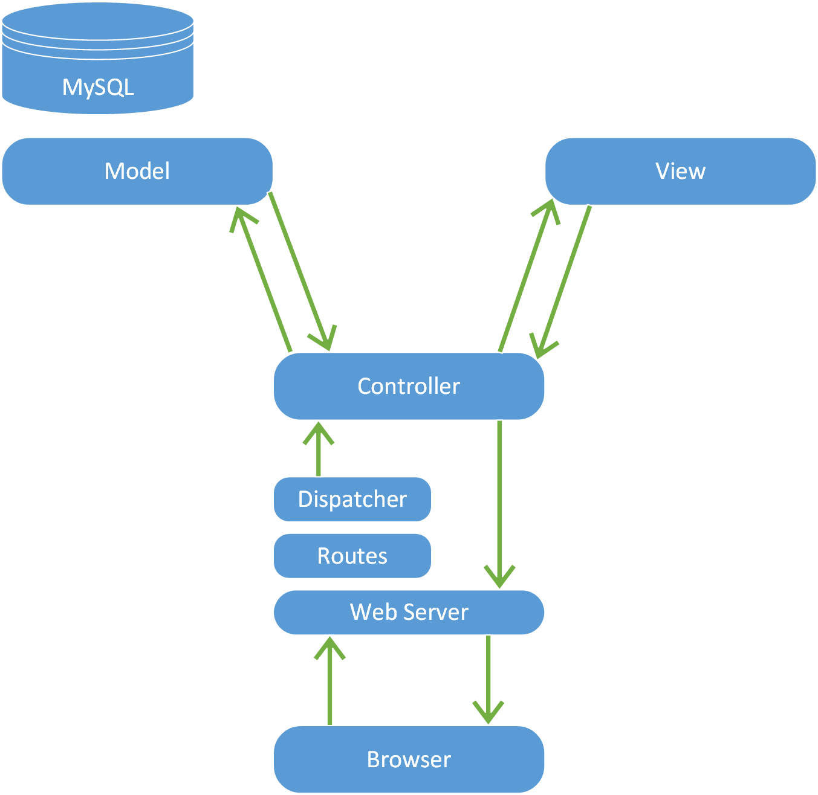
System Design: Architecture
Notes:
20 seconds
System design: Highlight the parts that you contributed to them.
1. System decomposition; identify the architecture patterns used
2. System deployment – h/w and s/w requirements

Slide 7
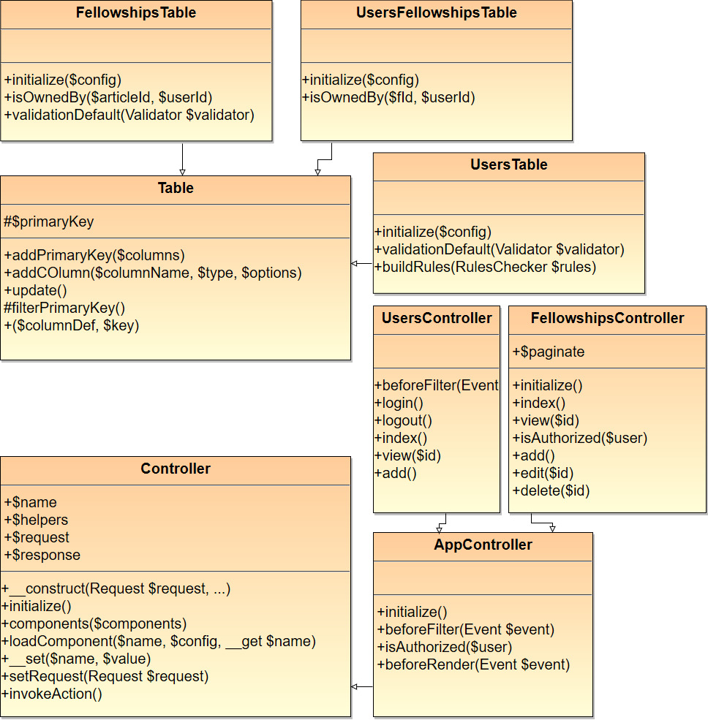
Minimal Class Diagram
Notes:
10 seconds.Minimal class diagram. Highlight the classes that you created/modified
Identify the design patterns used (one or more slides).

Slide 8
User Stories
1. User Story #132 : Register Profile
2. User Story #138 : Create Fellowship
3. User Story #139 : Edit Fellowship
4. User Story #146 : Remove Fellowship
5. User Story #149: Remove Fellow
Notes:
5 seconds.
List the user stories that you worked on them.(put in order of importance). Stay focused on the parts that you have been working.

Slide 9
User Story #132
User Story Name: Register Profile
As a user I would like to register a profile so that I can add fellowships to my account.
Acceptance Criteria
A user can create a profile.
A user is given an error if the profile username already exists.
A user can login to the created profile.
Use Case
Name: Register Profile
Actor: Regular User
Preconditions: The user has clicked the “Create Profile” link
Description <Flow of events>: If the regular user types in a username that is already taken and submits the form, then no profile is created. The regular user is prompted to enter a username that is not taken. The user types in a username that is not taken and submits the form. A profile is created. The user can login to his/her newly created profile.
Notes:
60 seconds
The tile of user story
The most important user story you worked on it. You have to describe this one very well and be proud of that.
Please present and show the complexity of your work, code, algorithms, and technical challenges and technologies you have used. (you could use screenshot if you want. Visual presentations are better than text presentation)
Go into the details of the most important/significant tasks using bullet lists or visual graphs or state chart diagram
Sequence Diagram for this user story is mandatory (in another separate page if required)
Demo using screenshots or GIF (in another separate page if required)

Slide 10
User Story #138
User Story Name: Create Fellowship
As an Admin User I would like to create a fellowship so that Fellow Users can view it and apply for it.
Acceptance Criteria
An Admin User can create a fellowship. The fellowship will appear in the main page of the site.
Use Case
Name: Create Fellowship
Actor: Admin User
Preconditions: The Admin User has logged in, navigated to the /admins/fellowships/ page, and clicked the “Add Fellowship” link.
Description <Flow of events>: The Admin User fills out the form completely and clicks submit. If there are no errors, then the fellowship can be viewed in the home page. If there was an error, then the user is sent back to the form to correct the error.
Notes:
20 seconds
The tile of user story
Please present and show the complexity of your work, code, algorithms, and technical challenges and technologies you have used. (you could use screenshot if you want. Visual presentations are better than text presentation) - Go into the details of the most important/significant tasks using bullet lists or visual graphs or state chart diagram - Demo using screenshots or GIF (in another separate page if required)
Sequence Diagram for this user story is optional

Slide 11
User Story #139
User Story Name: Edit Fellowship
As an Admin User I would like to edit a fellowship so that the website reflects the correct information.
Acceptance Criteria
An Admin User can edit a fellowship. The updated information for the fellowship will appear in the main page of the site.
Use Case
Name: Edit Fellowship
Actor: Admin User
Preconditions: The Admin User has logged in, and from the following URL http://localhost/fellowship/app/ the Admin User clicked on “Edit”.
Description <Flow of events>: The Admin User fills out the form completely and clicks submit. If no fields are empty, and the Admin User clicks “Update Fellowship”, then the updated fellowship can be viewed in the home page. If a field is empty, then the user is sent back to the form to fill the empty field.
Notes:
20 seconds
The tile of user story
Please present and show the complexity of your work, code, algorithms, and technical challenges and technologies you have used. (you could use screenshot if you want. Visual presentations are better than text presentation) - Go into the details of the most important/significant tasks using bullet lists or visual graphs or state chart diagram - Demo using screenshots or GIF (in another separate page if required)
Sequence Diagram for this user story is optional

Slide 12
User Story #146
User Story Name: Remove Fellowship
Description: As an Admin User I would like to remove a fellowship so that I can remove fellowships that are past its deadline.
Acceptance Criteria
The Admin User is able to remove a fellowship. Once the fellowship is removed it will no longer appear anywhere on the website.
Use Case
Name: Remove Fellowship
Actor: Admin User
Preconditions: The Admin User has logged in and is in the /admins/fellowships/ page.
Description <Flow of events>: The Admin User clicks the “Delete” link for a fellowship. A prompt will appear asking the user “Are you sure?”. If the user clicks “OK”, then the fellowship will be deleted from the fellowship list, and the page will reload. If the user clicks “Cancel”, then the fellowship will not be deleted from the fellowship list.
Notes:
20 seconds
The tile of user story
Please present and show the complexity of your work, code, algorithms, and technical challenges and technologies you have used. (you could use screenshot if you want. Visual presentations are better than text presentation) - Go into the details of the most important/significant tasks using bullet lists or visual graphs or state chart diagram - Demo using screenshots or GIF (in another separate page if required)
Sequence Diagram for this user story is optional

Slide 13
User Story #149
User Story Name: Remove Fellow
As an Admin User I would like to remove a fellow that has been inactive for a few years so that active users are displayed.
Acceptance Criteria
When an Admin User deletes a fellow from the Users List, then the fellow is removed from the User List.
When an Admin User deletes a fellow from the Users List, then the fellow is removed from fellowships he/she applied to.
Use Case
Name: Remove Fellow
Actor: Admin User
Preconditions: The Admin User is logged in and is viewing the Users List page.
Description <Flow of events>: The Admin User clicks the “Delete” link on a row that is associated with a fellow. The Admin User is prompted “Are you sure?”. If the Admin User clicks Ok, then the fellow is removed from the list. If the Admin User clicks Cancel, then the fellow stays on the list.
Notes:
20 seconds
The tile of user story
Please present and show the complexity of your work, code, algorithms, and technical challenges and technologies you have used. (you could use screenshot if you want. Visual presentations are better than text presentation) - Go into the details of the most important/significant tasks using bullet lists or visual graphs or state chart diagram - Demo using screenshots or GIF (in another separate page if required)
Sequence Diagram for this user story is optional

Slide 14
Test Suites and Test Cases
We use PHP Unit to Unit Test. We use this command in the Power Shell: php.exe .\phpunit-5.7.17.phar
Tests located in C:\wamp64\www\fellowship\app\tests\TestCase\Controller
Some test cases in the file:
public function testAddFellowshipPageLoadID138()
public function testEditFellowshipPageLoadID139()
public function testRemoveFellowshipPageLoadID146()
Notes:
10 seconds
A description of verification process and Test Suites and Test Cases for one of the use cases.
1 One sunny day and one rainy day for the implemented use cases (one or more slides).
2 Automated test scripts for the implemented use cases (if any) (one or more slides).

Slide 15







Summary
Summary
We used Github.com to share code; Google Docs for Scrum Meeting Minutes; and Mingle to share User Stories.
Contact Information
Alfredo Morales -
Winicius Siqueira - winicius@gmail.com
Questions?
Thank You!
Notes:
10 seconds
Summarize your contribution, mention your effort for Scrum, Mingle, Github, Google Drive Documentation and minutes
Include your contact information
Ask if anyone has any questions for you.
Thank your audience

